Slide 1
Cryptography
Lecture 7
Vahid Amin-Ghafari
Vahidaming@ustc.edu.cn

Slide 2
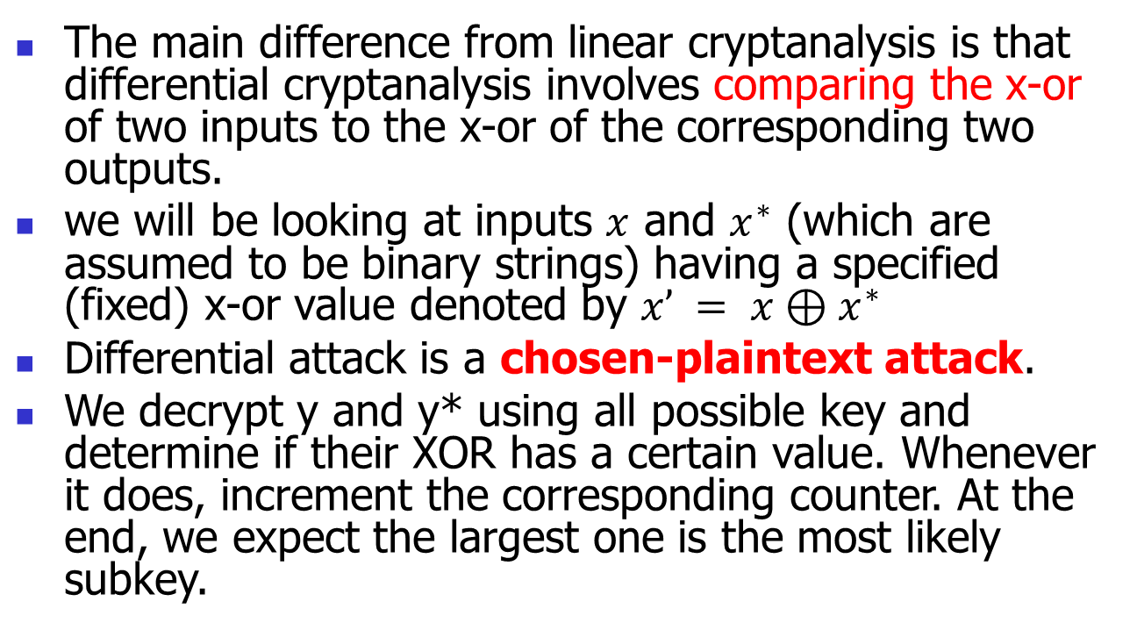
Differential Cryptanalysis
The main difference from linear cryptanalysis is that differential cryptanalysis involves comparing the x-or of two inputs to the x-or of the corresponding two outputs.
we will be looking at inputs $x$ and $x^{∗}$ (which are assumed to be binary strings) having a specified (fixed) x-or value denoted by $x’ = x⊕x^{∗}$
Differential attack is a chosen-plaintext attack.
We decrypt y and y* using all possible key and determine if their XOR has a certain value. Whenever it does, increment the corresponding counter. At the end, we expect the largest one is the most likely subkey.

Slide 3
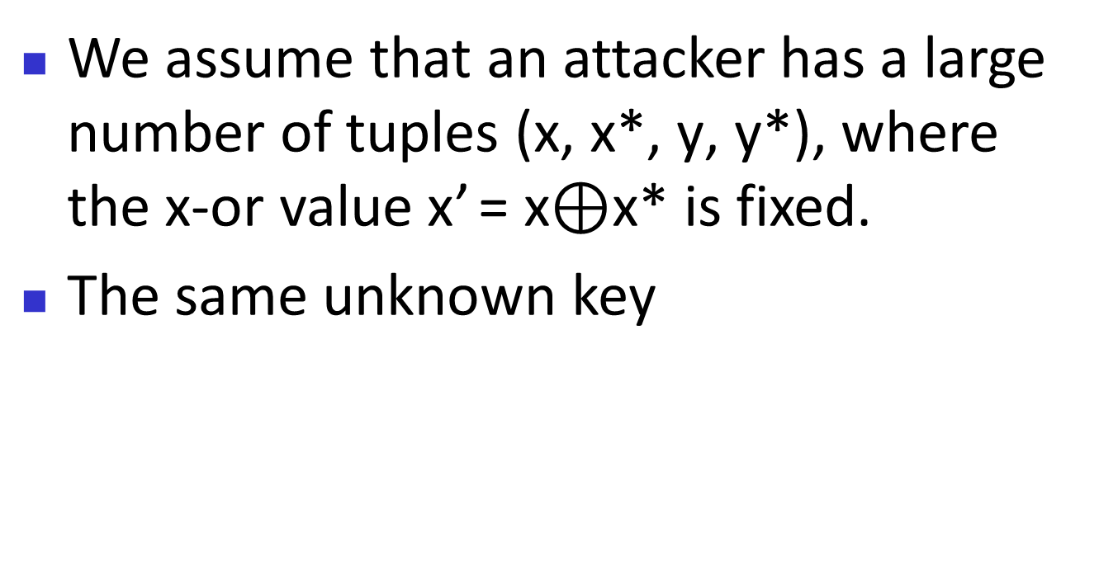
Differential Cryptanalysis
We assume that an attacker has a large number of tuples (x, x*, y, y*), where the x-or value x’ = x$⊕$x* is fixed.
The same unknown key

Slide 4
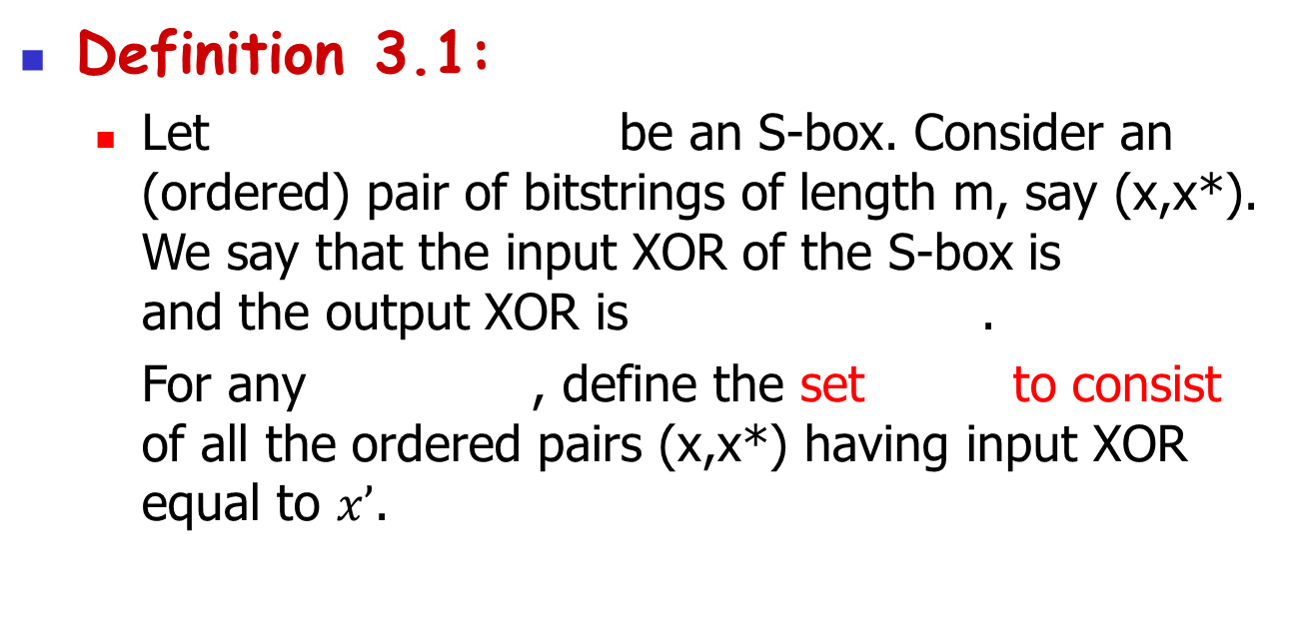
Differential Cryptanalysis
Definition 3.1:
Let be an S-box. Consider an (ordered) pair of bitstrings of length m, say (x,x*). We say that the input XOR of the S-box is and the output XOR is .
For any , define the set to consist of all the ordered pairs (x,x*) having input XOR equal to $x’$.

Slide 5
Differential Cryptanalysis
It is easy to see that any set contains 2^{m} pairs, and that
For each pair in , we can compute the output XOR of the S-box. Then we can tabulate the distribution of output XORs. There are 2^{m} output XORs which are distributed among 2^{n} possible values.
A non-uniform output distribution will be the basis for a successful attack.

Slide 6

Differential Cryptanalysis
Example 3.3:
We use the same S-box as before. Suppose we consider input XOR $x’=1011$. Then
We compute the following table, where

Slide 7
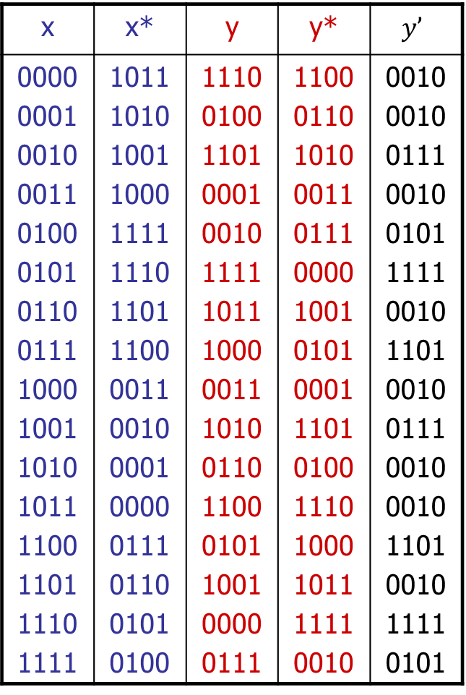
x | x* | y | y* | $$y’$$
0000 0001 0010 0011 0100 0101 0110 0111 1000 1001 1010 1011 1100 1101 1110 1111 | 1011 1010 1001 1000 1111 1110 1101 1100 0011 0010 0001 0000 0111 0110 0101 0100 | 1110 0100 1101 0001 0010 1111 1011 1000 0011 1010 0110 1100 0101 1001 0000 0111 | 1100 0110 1010 0011 0111 0000 1001 0101 0001 1101 0100 1110 1000 1011 1111 0010 | 0010 0010 0111 0010 0101 1111 0010 1101 0010 0111 0010 0010 1101 0010 1111 0101
0000 | 0 | 1000 | 0
0001 | 0 | 1001 | 0
0010 | 8 | 1010 | 0
0011 | 0 | 1011 | 0
0100 | 0 | 1100 | 0
0101 | 2 | 1101 | 2
0110 | 0 | 1110 | 0
0111 | 2 | 1111 | 2
Number of output
Distribution table for x’=1011

Slide 8
Differential Cryptanalysis
In Example 3.3, only 5 of the 16 possible output XORs occur. It has a very non-uniform distribution.
We can compute all possible input XORs as Example 3.3.
Define
N_{D}(x’,y’) counts the number of pairs with input XOR equal to x’ and output XOR equal to y’. (Figure 3.4)

Slide 9
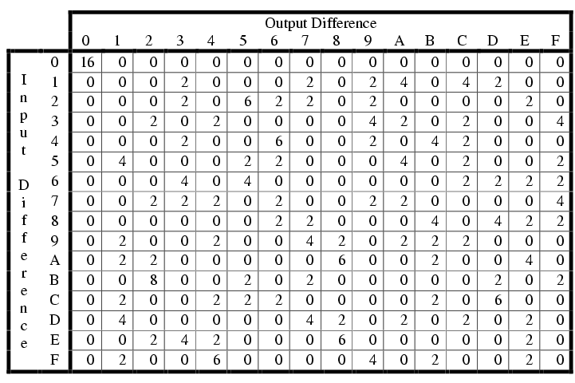
Example 3.3
Figure 3.4: Difference distribution table: values of N_{D}(x’,y’)

Slide 10
Differential Cryptanalysis
An input XOR is computed as
Therefore, the input XOR does not depend on the subkey bits used in round r; it is equal to the (permuted) output XOR of round r-1.
Let a’ denote the input XOR and let b’ denote the output XOR. (a’,b’) is called a differential.

Slide 11
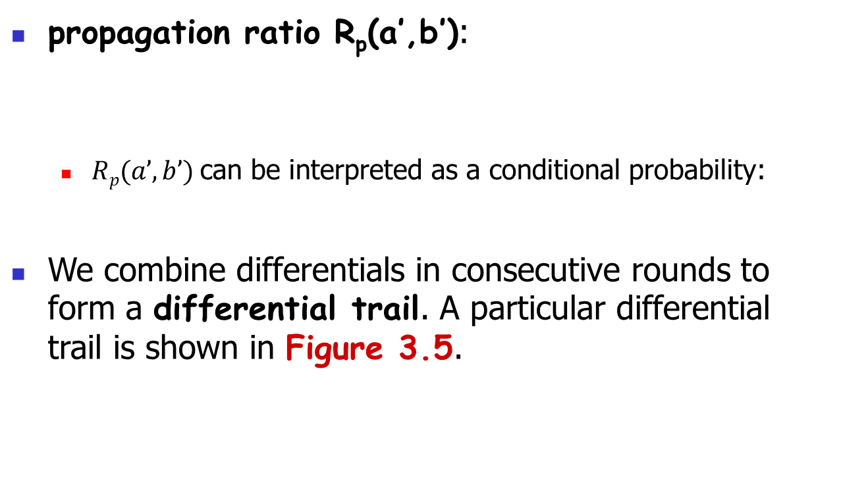
Differential Cryptanalysis
propagation ratio R_{p}(a’,b’):
$Rp(a’,b’)$can be interpreted as a conditional probability:
We combine differentials in consecutive rounds to form a differential trail. A particular differential trail is shown in Figure 3.5.

Slide 12
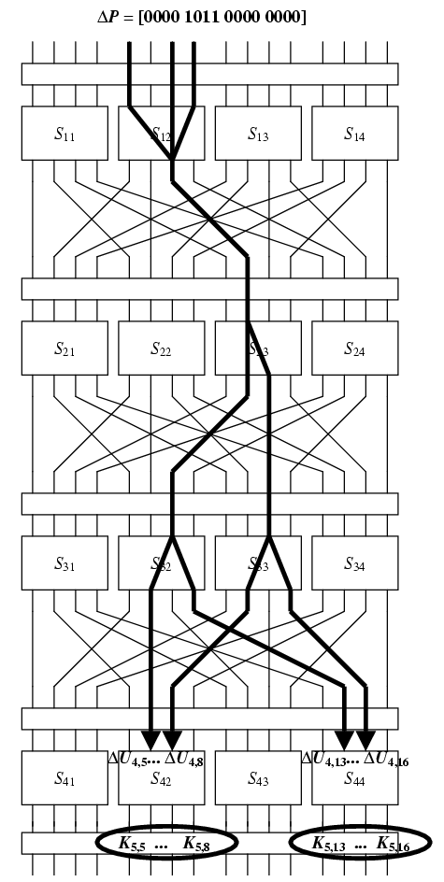
x
u¹
v¹
w¹
u²
v²
w²
u³
v³
w³
u⁴
Figure 3.5: A differential trail for a SPN
v⁴
y

Slide 13
Differential Cryptanalysis
The differential attack arising from Figure 3.5 uses the following propagation ratios of differentials:
In
In
In
In
We therefore obtain a propagation ratio for a differential trail of the first three rounds of the SPN:

Slide 14
Differential Cryptanalysis
In other words,
with probability 27/1024. However,
Hence, it follows that
with probability 27/1024.

Slide 15
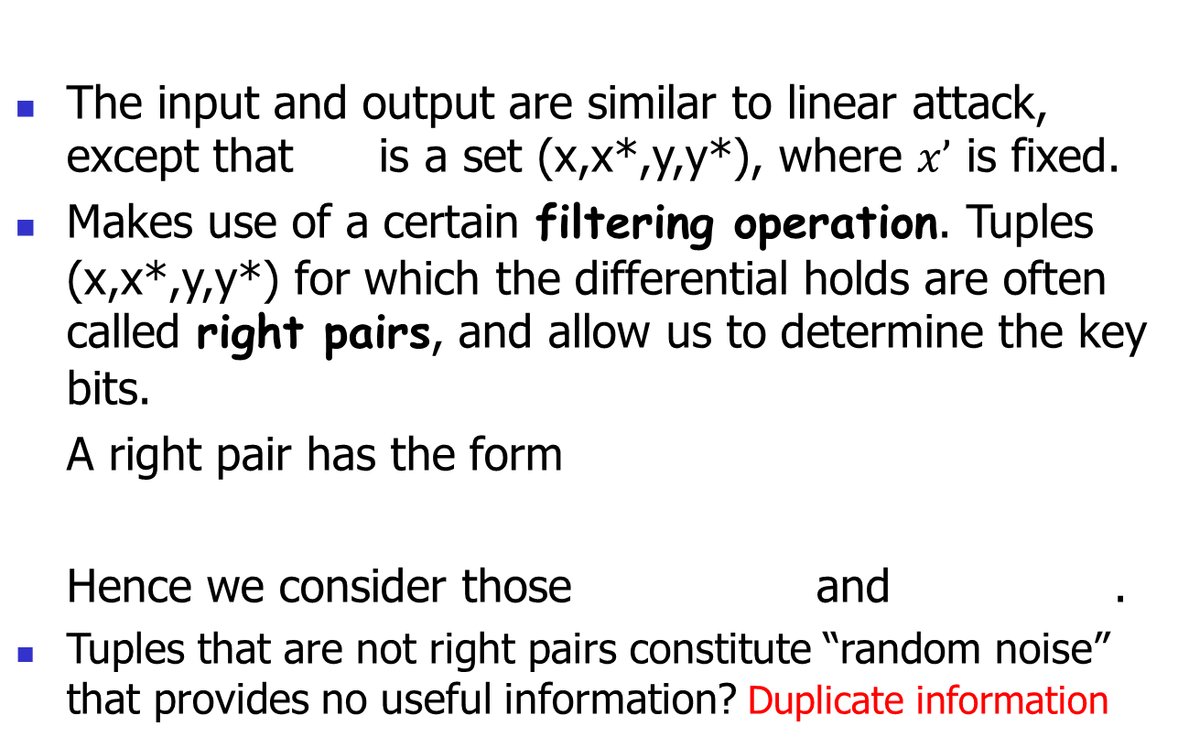
Differential Cryptanalysis
The input and output are similar to linear attack, except that is a set (x,x*,y,y*), where $x’$ is fixed.
Makes use of a certain filtering operation. Tuples (x,x*,y,y*) for which the differential holds are often called right pairs, and allow us to determine the key bits.
A right pair has the form
Hence we consider those and .
Tuples that are not right pairs constitute “random noise” that provides no useful information? Duplicate information

Slide 16
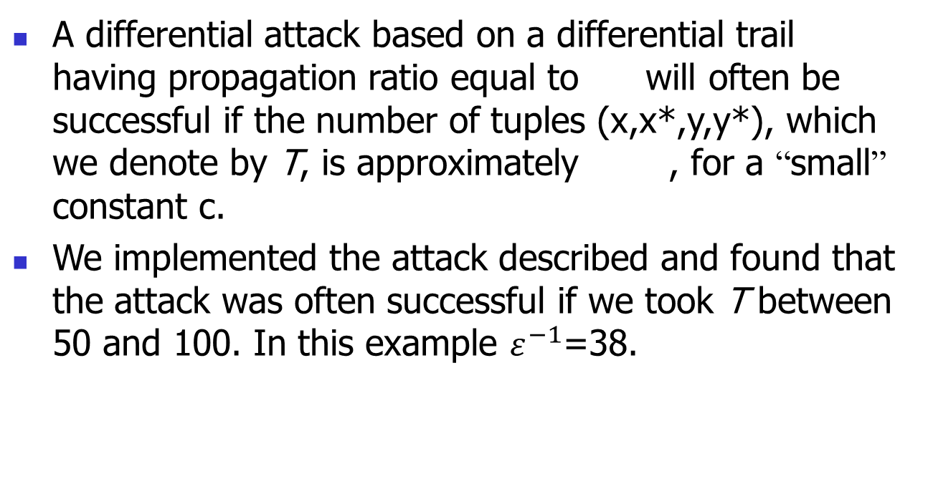
Differential Cryptanalysis
A differential attack based on a differential trail having propagation ratio equal to will often be successful if the number of tuples (x,x*,y,y*), which we denote by T, is approximately , for a “small” constant c.
We implemented the attack described and found that the attack was often successful if we took T between 50 and 100. In this example $ε^{−1}$=38.

Slide 17
Differential Cryptanalysis

Slide 18
Differential Cryptanalysis

